Slide 1
Parallel and distributed processing of big data Elioz Geller & Yanir Avitan Functional programming in concurrent and distributed systems course Lecturer's name -Dr. Yehuda Ben-Shimol Practitioner's name -Mr. David Leon Ben GurionUniversity, Beer Sheva, ISRAEL

Slide 2
About
In this project we will use map reduce to analyze big data in parallel and distributed systems with Erlang programming language.
This program analyze big data from www.dblp.org and create tree of the partners for the author that the user chooses. In addition this program displays a table of the number of surnames beginning with the same letter at each level in the tree.

Slide 3
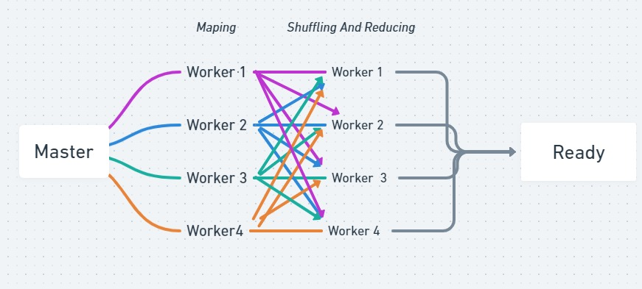
MapReduce - Processing stage

Slide 4
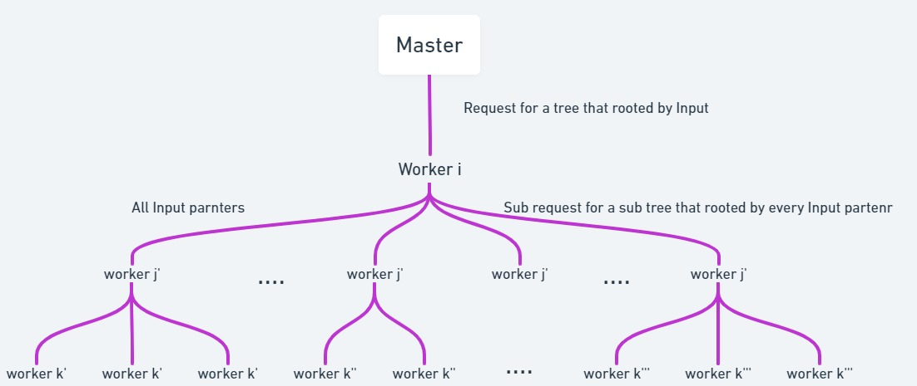
Tree construct stage

Slide 5
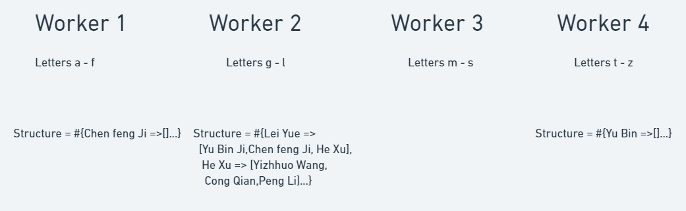
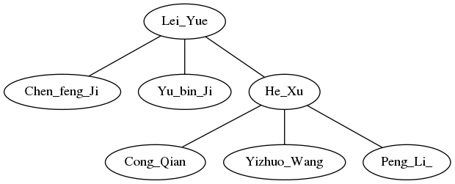
Tree construct stage - example

Slide 6
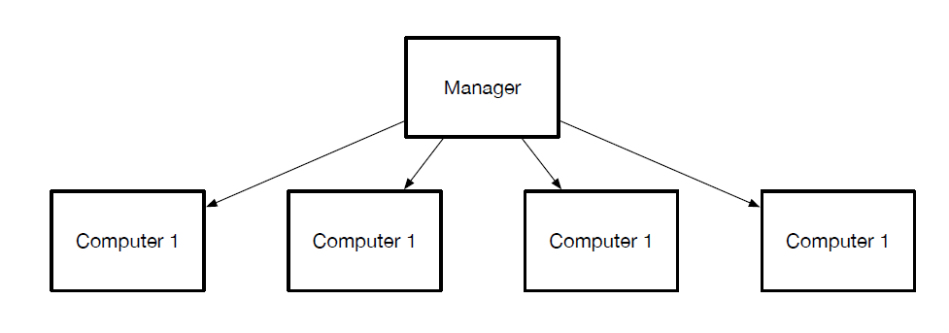
Multiple computers
Our software is unlimited in the number of computers that will participate in the process.

Slide 7
Master - state machine

Slide 8
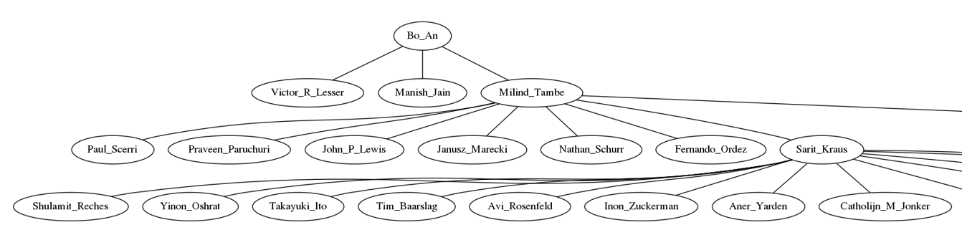
Dynamic code
There is no limit to the amount of computers that can participate in processing.
There is a DEFINE to control the depth of the tree we get.

Slide 9
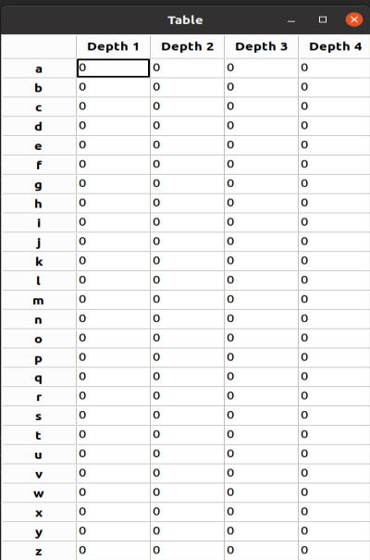
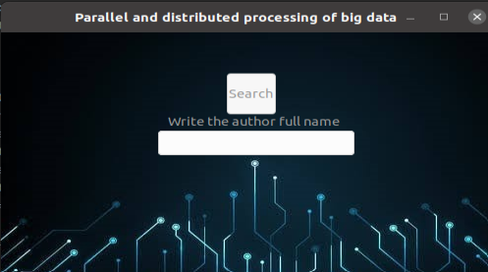
GUI
Simple interface for users.

Slide 10
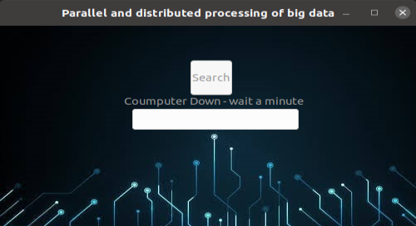
Disconnect computer
This program can handle with computers disconnect while processing.

Slide 11
Statistics

Slide 12
Youtube & GitHub
Link for Youtube video:
https://www.youtube.com/watch?v=7HWlEaO4jUk
Link for Github project:
https://github.com/yanir26/Parallel-and-distributed-processing-of-big-data

Slide 13
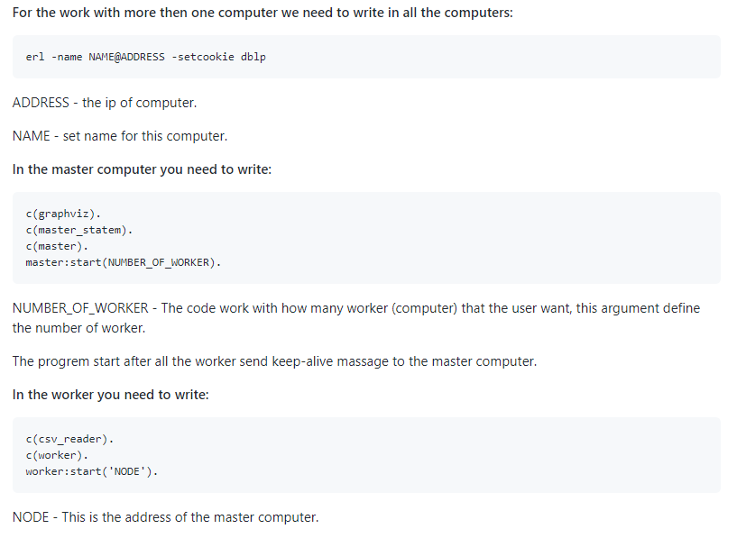
How to run the program

Slide 14
thanks for listening any questions ?

